Slide 1
From Today’s Internet
to the Network of 2035
How could AI, quantum technology, blockchain, and 6G change future networks?
FUTURE NETWORKS

Slide 2
01 / FOUNDATIONS
Today’s network challenges
01
02
03
04
Latency
Congestion
Packet loss
Throughput
Delay in communication
Traffic exceeds available resources
Packets fail to reach their destination
Data delivered successfully over time
Why it matters
Congestion can increase queuing delay and may contribute to packet loss. A bottleneck limits the performance of the whole connection.
02

Slide 3
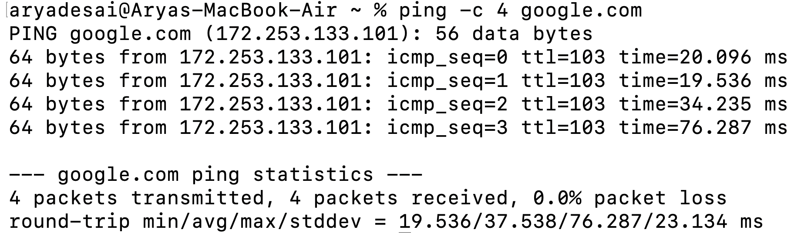
02 / OBSERVATION
My network experiment: ping
TERMINAL / ping -c 4 google.com
0%
37.538 ms
19–76 ms
Packet loss
Average RTT
Observed range
Interpretation
• All four probes received replies.
• Response times varied.
• This short test cannot identify the exact cause.
03

Slide 4
03 / INTELLIGENT MANAGEMENT
AI-native networking
AI can support three network-management tasks
Predict
Optimize
Detect
Spot traffic growth and possible congestion
Recommend routes and allocate resources
Identify faults or unusual traffic
MAIN CAUTION
AI depends on reliable data. Wrong predictions or unsafe automated changes can disrupt service, so important actions need monitoring and oversight.
04

Slide 5
04 / SPECIALIZED COMMUNICATION
Quantum networking
What makes it different?
SIMPLIFIED QUANTUM LINK
• Carries quantum information
• May use photons and quantum states
• Quantum repeaters remain a research challenge
photon link
Node A
Node B
Conceptual only — quantum links are not ordinary IP packet paths.
Large-scale quantum networking remains experimental; it is not a universal replacement for the Internet.
05

Slide 6
05 / PROTECTING CLASSICAL DATA
Post-quantum security
THE RISK
THE RESPONSE
A sufficiently capable quantum computer could threaten some public-key cryptography used today.
PQC uses algorithms designed to resist attacks from classical and quantum computers.
NIST published three post-quantum cryptography standards in 2024.
PQC protects classical digital communication. Quantum networking is about communicating quantum information.
06

Slide 7
06 / SHARED RECORDS
Blockchain in networking
Where it might help
What to watch
• Device identity records
• Access-change logs
• Shared security auditing
• Latency and storage
• Privacy and complexity
• Consensus overhead
If one trusted organization controls the data, a traditional database may be simpler.
07

Slide 8
07 / ADDITIONAL TECHNOLOGY
6G: the next mobile generation
Potential direction
Challenges
• Future mobile connectivity
• AI-enabled communication
• Connected devices and immersive services
• Standards and testing
• Infrastructure and energy costs
• Coverage and implementation
CURRENT STATUS: Emerging / standardization — not a fully deployed commercial generation.
08

Slide 9
08 / ARCHITECTURE
Protocol layers still matter
APPLICATION
AI services • blockchain applications
TRANSPORT
TCP / UDP
NETWORK
IP routing • AI-assisted routes
LINK
Wi-Fi • 5G / 6G radio links
PHYSICAL
Fiber • radio signals
Encapsulation: Message → Segment → Packet → Frame → Bits
09

Slide 10
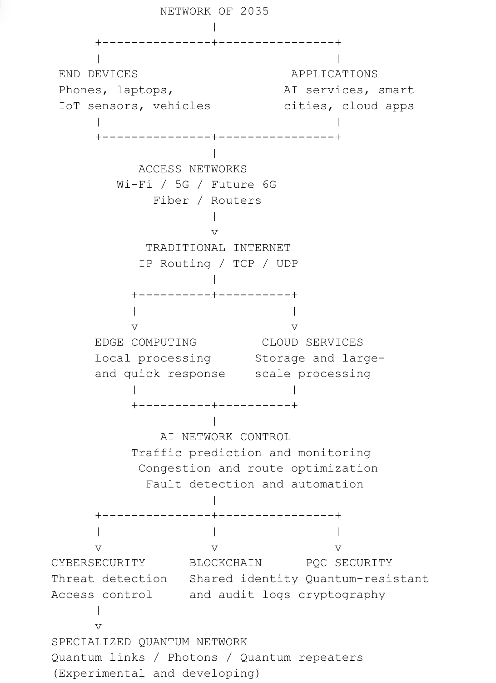
09 / PROPOSED ARCHITECTURE
My Network of 2035
HOW THE ARCHITECTURE WORKS
01
Classical data path
Devices connect through Wi-Fi, 5G/6G, fiber and routers. Ordinary traffic continues to use IP, TCP and UDP.
02
AI network controller
Monitors traffic and predicts congestion, supports route optimization, and helps detect faults.
03
Security and trust
Cybersecurity handles threat detection and access control; post-quantum cryptography protects against future quantum attacks.
04
Blockchain and quantum
Blockchain can support selected identity and audit records. Quantum links are specialized and remain experimental/developing.
Security spans the architecture; blockchain does not carry every packet.
10

Slide 11
10 / ANALYSIS
Comparison and my prediction
TECHNOLOGY
MAIN PURPOSE
MATURITY
AI networking
Management and optimization
Deployed / emerging
Quantum networking
Quantum information
Experimental
Post-quantum security
Protect classical cryptography
Standards published; migration ongoing
Blockchain
Shared, verifiable records
Application-dependent
6G
Future mobile connectivity
Emerging / standardization
My prediction: AI-native networking may have the broadest everyday impact.
It can improve existing networks through prediction, fault detection, and controlled automation.
11

Slide 12
11 / TAKEAWAYS
Conclusion
The future is more likely to extend the Internet than replace it.
SELECTED REFERENCES
• AI may make network management more intelligent.
• 6G may improve future wireless connectivity.
• PQC, blockchain, and quantum networking have different roles.
Boutaba et al. — ML for networking (2018)
Azuma et al. — Quantum repeaters (2023)
NIST — PQC standards (2024)
Yaga et al. — Blockchain overview (2018)
ITU — IMT-2030 framework (2023)
Reyna et al. — Blockchain and IoT (2018), doi: 10.1016/j.future.2018.05.046
Thank you.
12

